Slide 1

Bright Coffee Shop
Bright Coffee Shop Sales Analysis.
THE WORLD OF
COFFEE

Slide 2
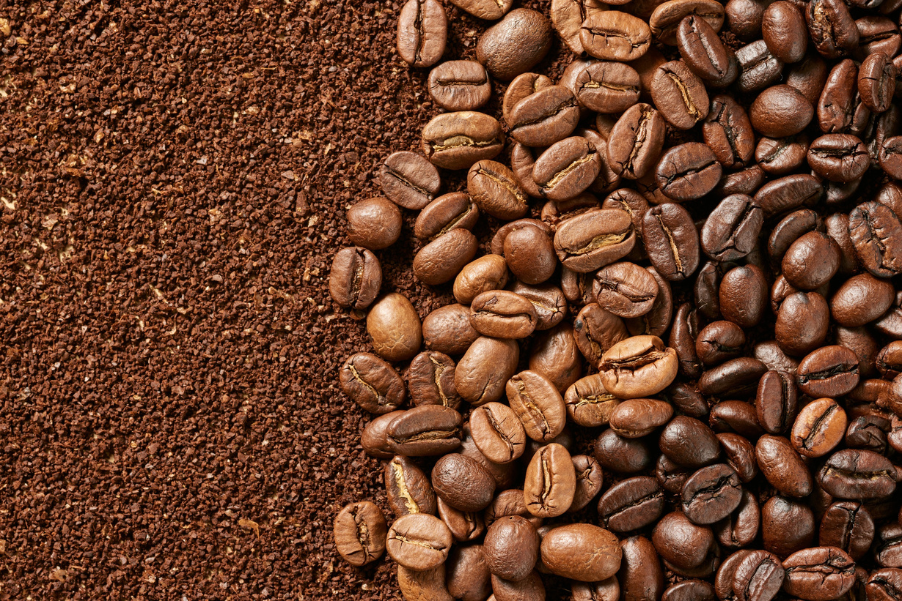
Bright Coffee Shop
TABLE OF CONTENTS
Overview
Performance deep dive
Key findings
Recommendations
Q & A

Slide 3

OVERVIEW
Bright Coffee Shop
Product categories:
Bakery
Branded
Coffee
Coffee beans
Drinking Chocolate
Flavours
Loose tea
Packaged Chocolate
Tea
The Total revenue stands at R698 812.33 with a growing trend across all three locations. We have nine product categories in each store, and only two are performing well.
Stores:
ASTORIA.
HELL’S KITCHEN.
LOWER MANHATTAN.

Slide 4
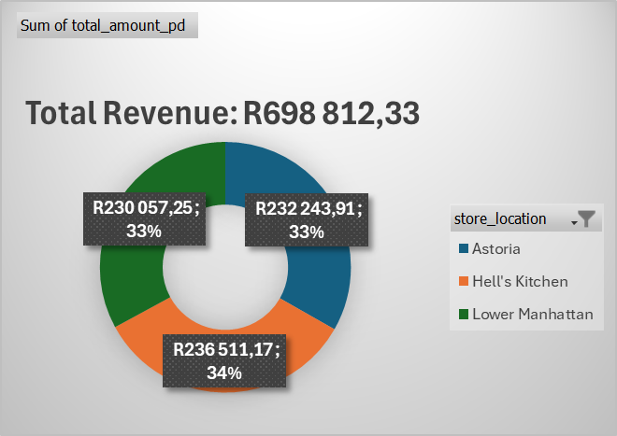
PERFORMANCE DEEP DIVE
Bright Coffee Shop
Hell’s Kitchen slightly outperforms the other locations, contributing 33.84% of total revenue, followed closely by Astoria and Lower Manhattan at 33.23% and 32.92% respectively. However, the differences are minimal(less than 1%), indicating balanced performance across all stores.

Slide 5
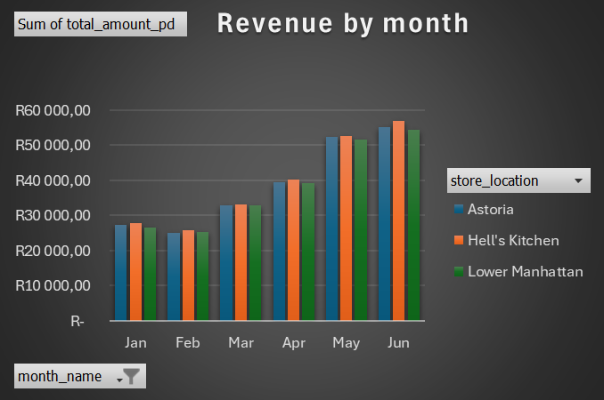
Bright Coffee Shop
Revenue starts at a relatively stable level, then decreases in March. From March to June, it consistently increases across all locations. This suggests possibly seasonal demand building up over time.
Hell’s Kitchen generates the highest revenue among the three stores, with Astoria following, and Lower Manhattan is behind but still follows the same trend. The gap between the stores is small; Hell’s Kitchen has a slight competitive edge in later months.
Hell's Kitchen
Astoria
Lower Manhattan
R236,511 total (33.84)
R232,244 total (33.23%)
R230,057 total (32.92%)

Slide 6
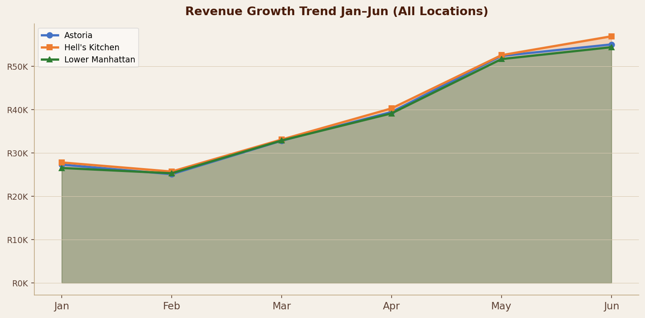
REVENUE GROWTH TREND — Jan to Jun 2023
Consistent growth across all locations — R81K in Jan rising to R166K in Jun (+104%)

Slide 7
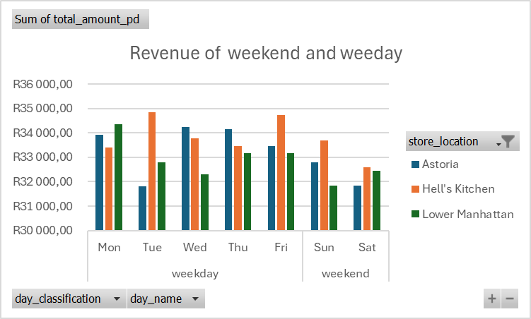
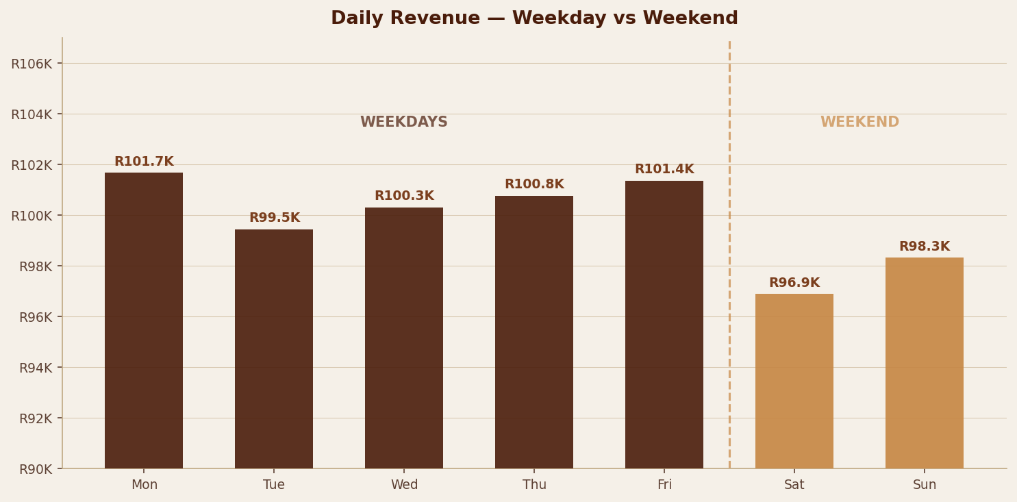
Bright Coffee Shop
Key findings
Weekdays generate R503,588 (72%) vs R195,225 (28%) on weekends. The business is clearly weekday-driven.
Mon & Friday generates the highest weekday revenue R101,677 and R101,373. Tuesday(R99,456)-slight dip which consider Tuesday promotions
Sunday slightly outperforms Saturday. Weekdays earn 2.6X more than weekend .

Slide 8
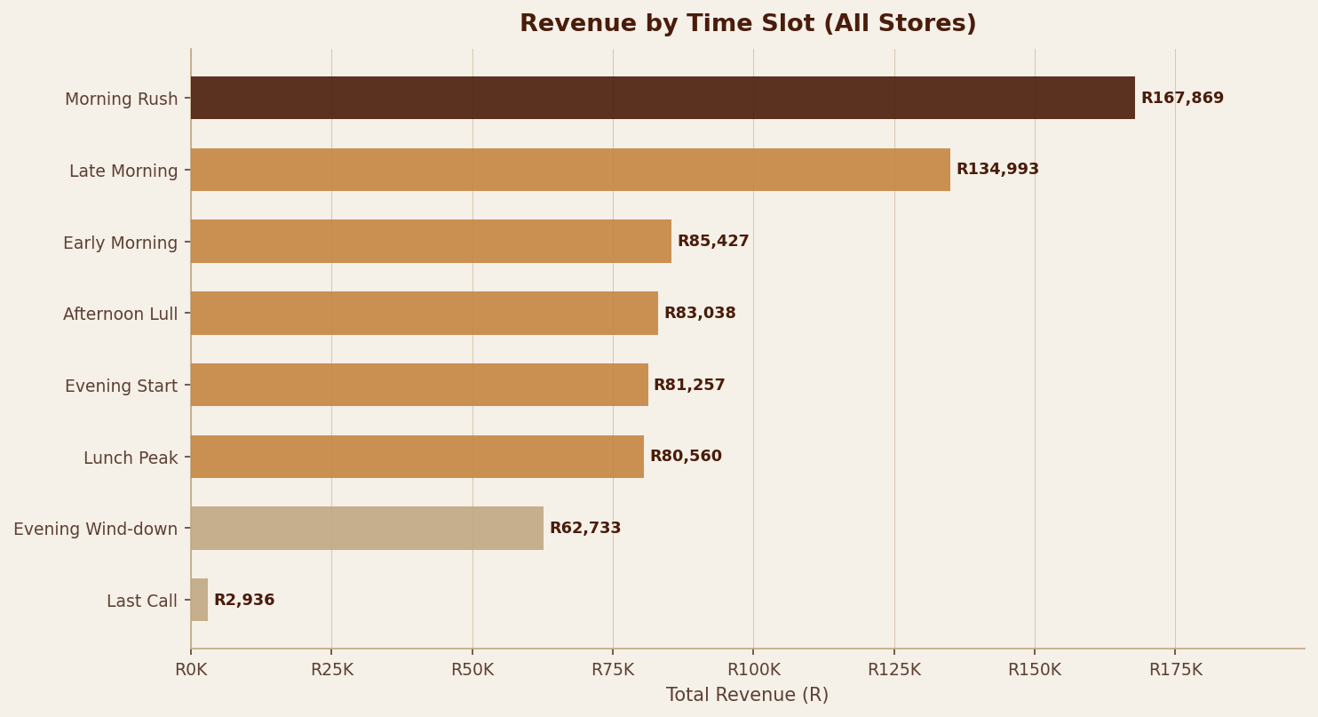
Bright Coffee Shop
Morning Rush
R167,869 — highest slot (24% of total revenue)
Late Morning
R134,993 — strong follow-up (19.3% of total revenue)
Last Call
R2,936 — virtually zero Opportunity: delivery & takeaway
Action
Focus staff & promotions on low performing time slots
Morning Rush generates R167,869 — 24% of all revenue | Last Call is virtually zero at R2,936

Slide 9
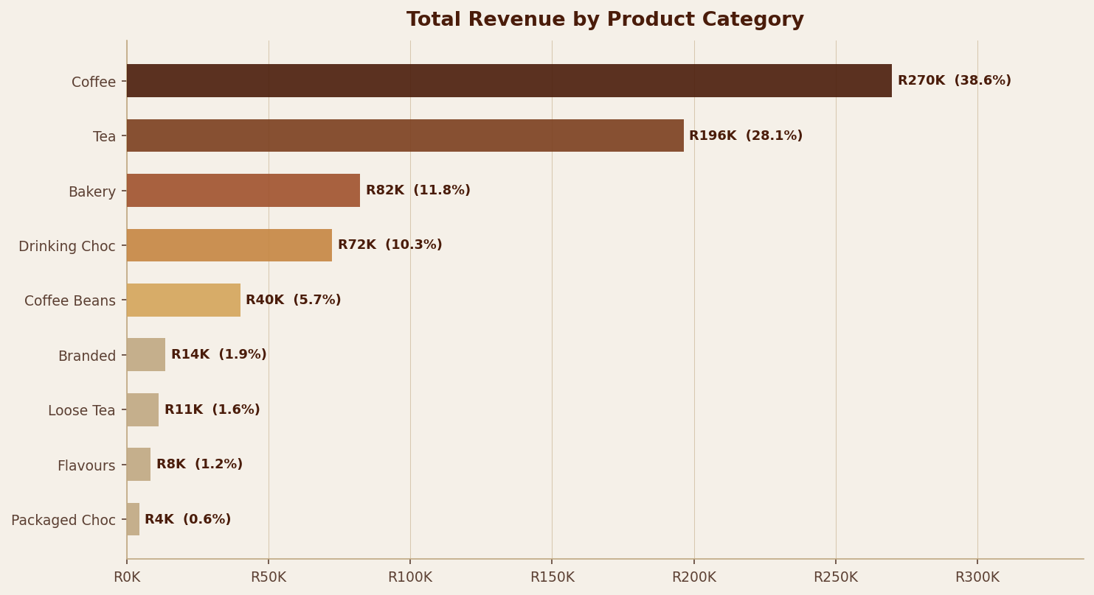
Bright Coffee Shop
Coffee
R269,952 — dominant category 38.6% of total revenue
Tea
R196,406 — strong second 28.1% of total revenue
Coffee Beans
R40,085 (5.7%) — low despite high coffee demand
Others (3 cats)
Flavours + Loose Tea + Packaged Choc = R24,030 combined (3.4%) — review
Coffee (38.6%) + Tea (28.1%) = 66.7% of all revenue — they are the business backbone. Although Coffee is dominant, Coffee beans is underperforming. This indicates customer buying coffee to consume rather than purchasing beans for home brewing.

Slide 10
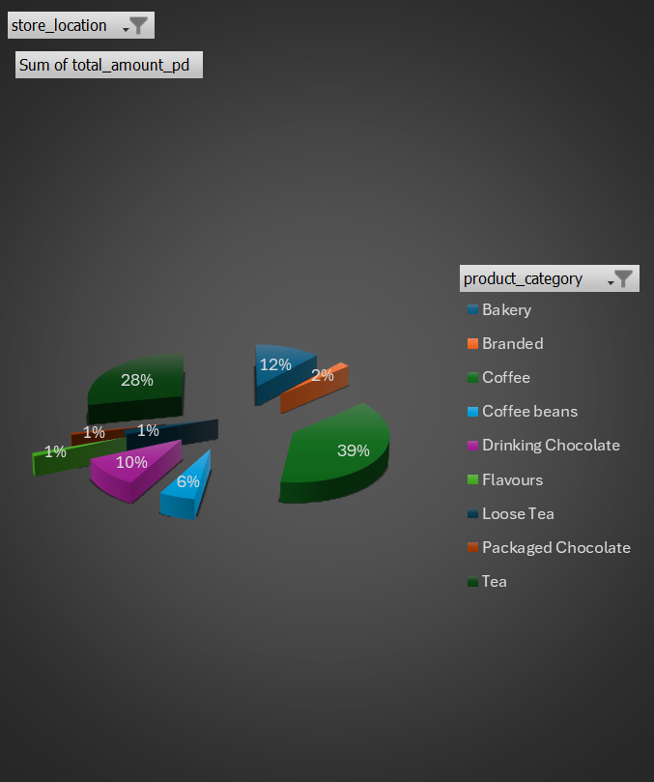
Bright Coffee Shop
Recommendations
Revenue split: Coffee & Tea = 67% | Bakery & Drinking Chocolate = 22% | Coffee Beans = 6% | Others = 5%
Focus inventory and marketing on the two high-performing categories and two secondary-performing categories. Promote the secondary performing categories by creating combo deals.
We can phase out the five weakest categories and use the space to grow coffee bean sales/or make promotions.
Hell’s Kitchen outperforms Astoria and Lower Manhattan in every category, so we can replicate the store’s success.

Slide 11
Bright Coffee Shop
Launch an afternoon happy hour during the afternoon lull hours. It captures less of the daily revenue compared to the morning peak hours. Boost weekend sales with special promotions and improve weekday service speed. Expand the menu with cold beverages, indulgent treats, and child-friendly items to attract new customer segments and boost performance during low months.
Turn holidays into revenue opportunities. Host special events and limited-time offerings for major holidays. If the low performing categories are not phased out, launch a birthday rewards program offering special discounts and free items to customers on their birthdays, such as branded items.
Implement a social media strategy on few social media platforms. Build a loyal following and offer exclusive percentage-off discounts to followers to drive traffic during slow periods. Create simple, fun, and visually engaging activities at your coffee shop that content creators will want to film and share with their followers.
Launch a loyalty card program where customers earn points or stamps with every purchase, redeemable for free items after a certain number of visits. Launch delivery and takeaway services through delivery platforms partnerships and takeaway-focused promotions, with special emphasis on last call hours.

Slide 12
NEXT STEPS
Turning insights into action
Automate Daily Sales Reporting
Launch Loyalty Card Programme
01
Set up a scheduled pipeline to automatically refresh sales data every morning, so the team always starts the day with up-to-date numbers if no manual work.
02
Stamp-based rewards during peak morning hours to increase repeat visits and capture more weekend customers.
Track Competitor Pricing & Menu Trends
Replicate Hell's Kitchen Model
03
Conduct quarterly competitor audits — track menu pricing, promotions, and new product launches from nearby coffee shops to ensure Bright stays competitive and relevant.
04
Audit what drives Hell's Kitchen's edge, then roll out the same staffing and product mix to other locations.
Phase Out Weak Categories
Run Seasonal Promotions
05
60-day decision gate: run a promo campaign for Flavours, Loose Tea & Packaged Choc — if no lift, phase out.
06
Use the slow months (January and February) to run targeted promotions — special offers, limited-time menu items, and themed campaigns to drive foot traffic when sales dip.

Slide 13


Bright Coffee Shop
THANK YOU
Q&A?

